Slide 1

Online Starbucks Store
Jagmohan Singh
Sagar Dafle
Shubham Vadhera
Pooja Yelure

Slide 2






Architecture
AWS
MongoDB Cluster
Load
Balancer
MongoDB Rest Service - GO
Secondary
1
Primary
Secondary
2
NodeJS
Web Server
Heroku

Slide 3
Components
MongoDB - replication
AWS
Go for MongoDB Rest Service
Heroku – PaaS
NodeJS
AngularJS
ExpressJS
Bootstrap

Slide 4
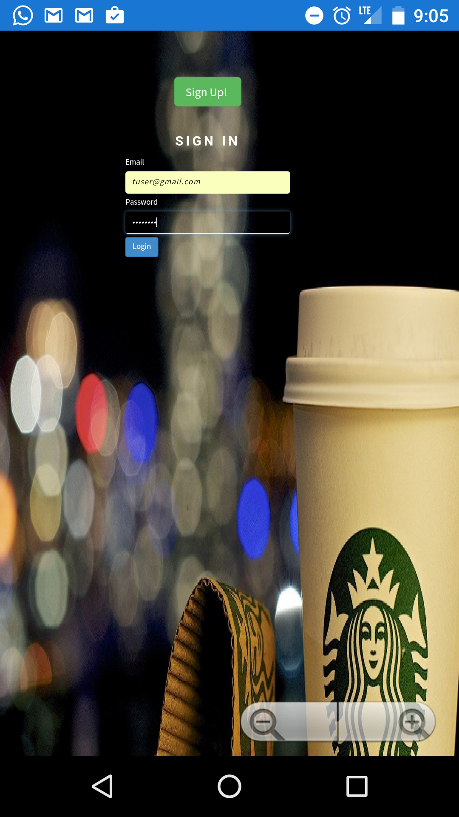
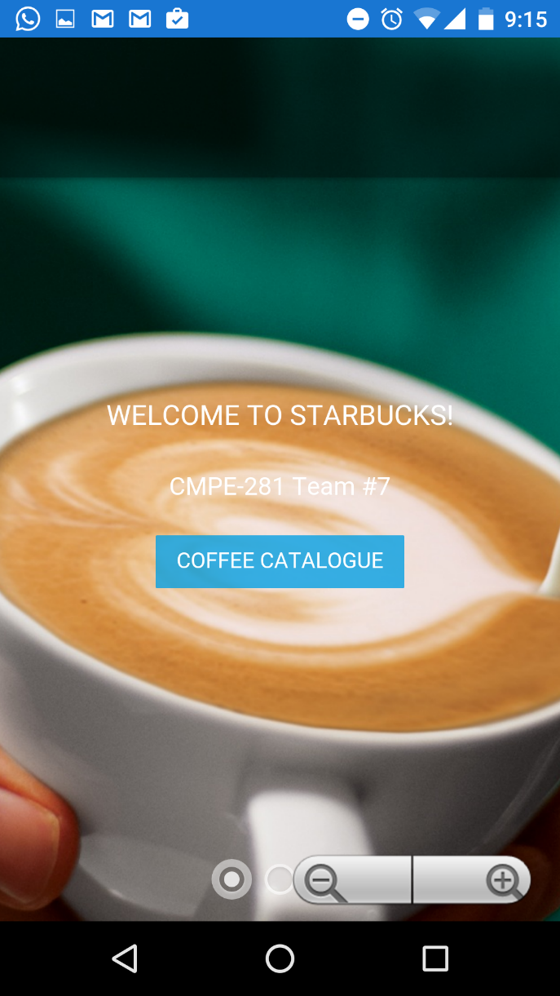
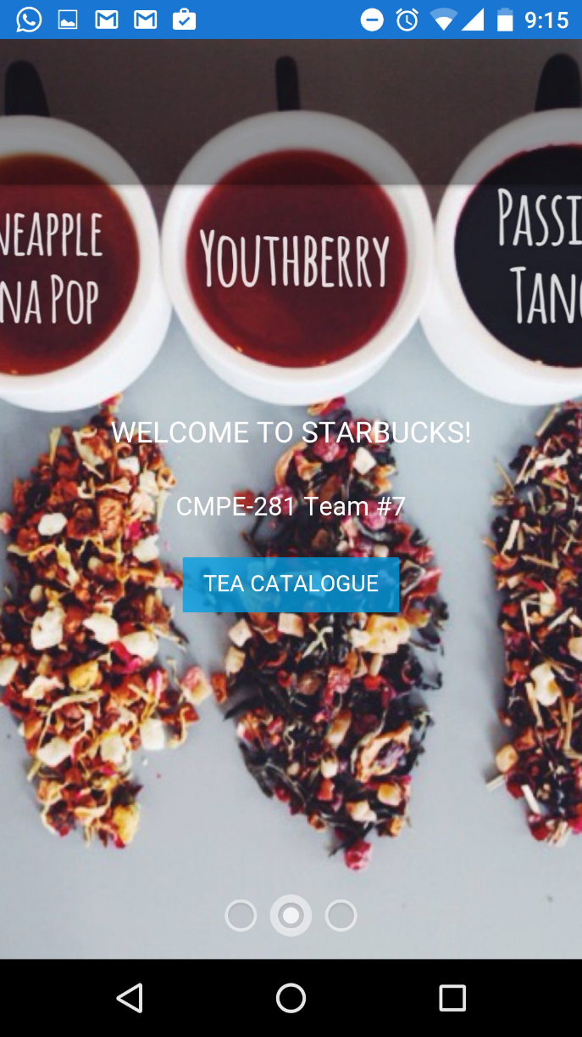
Andriod App

Slide 5
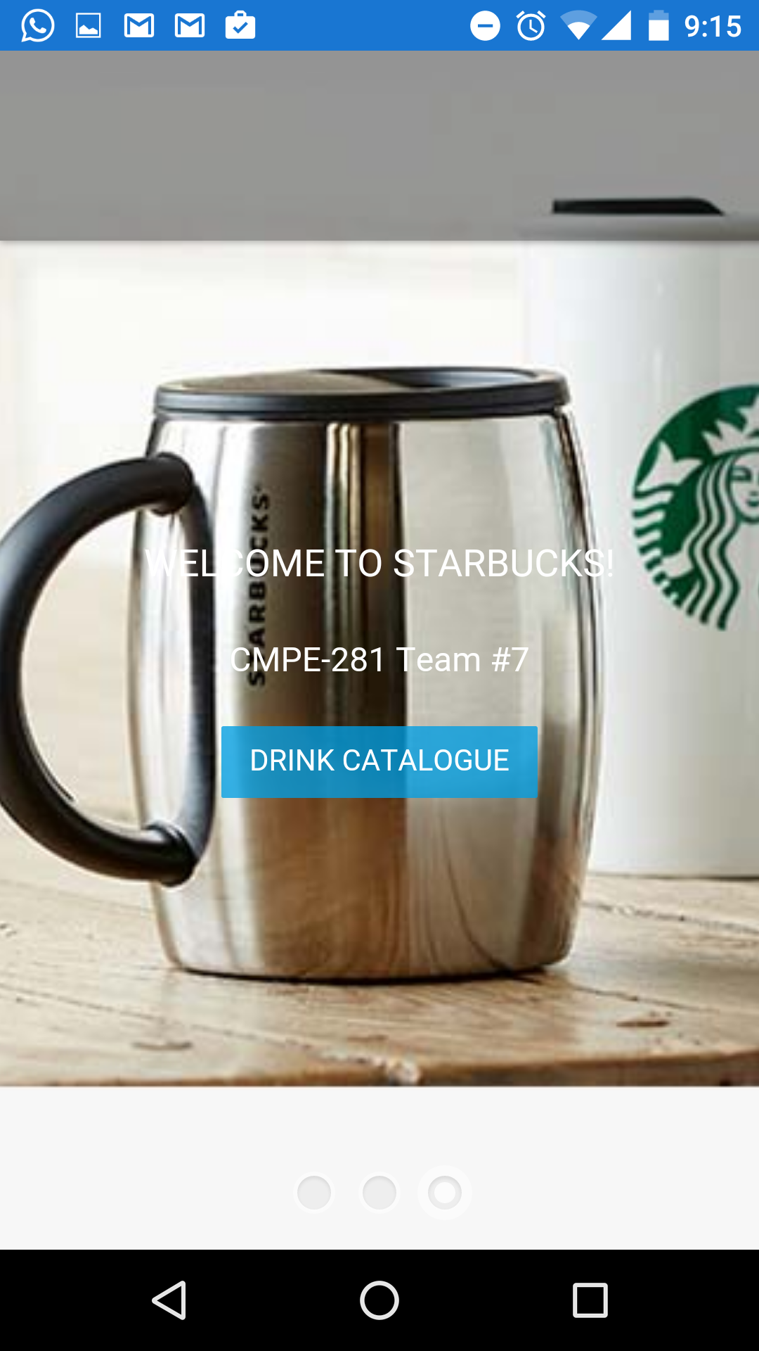
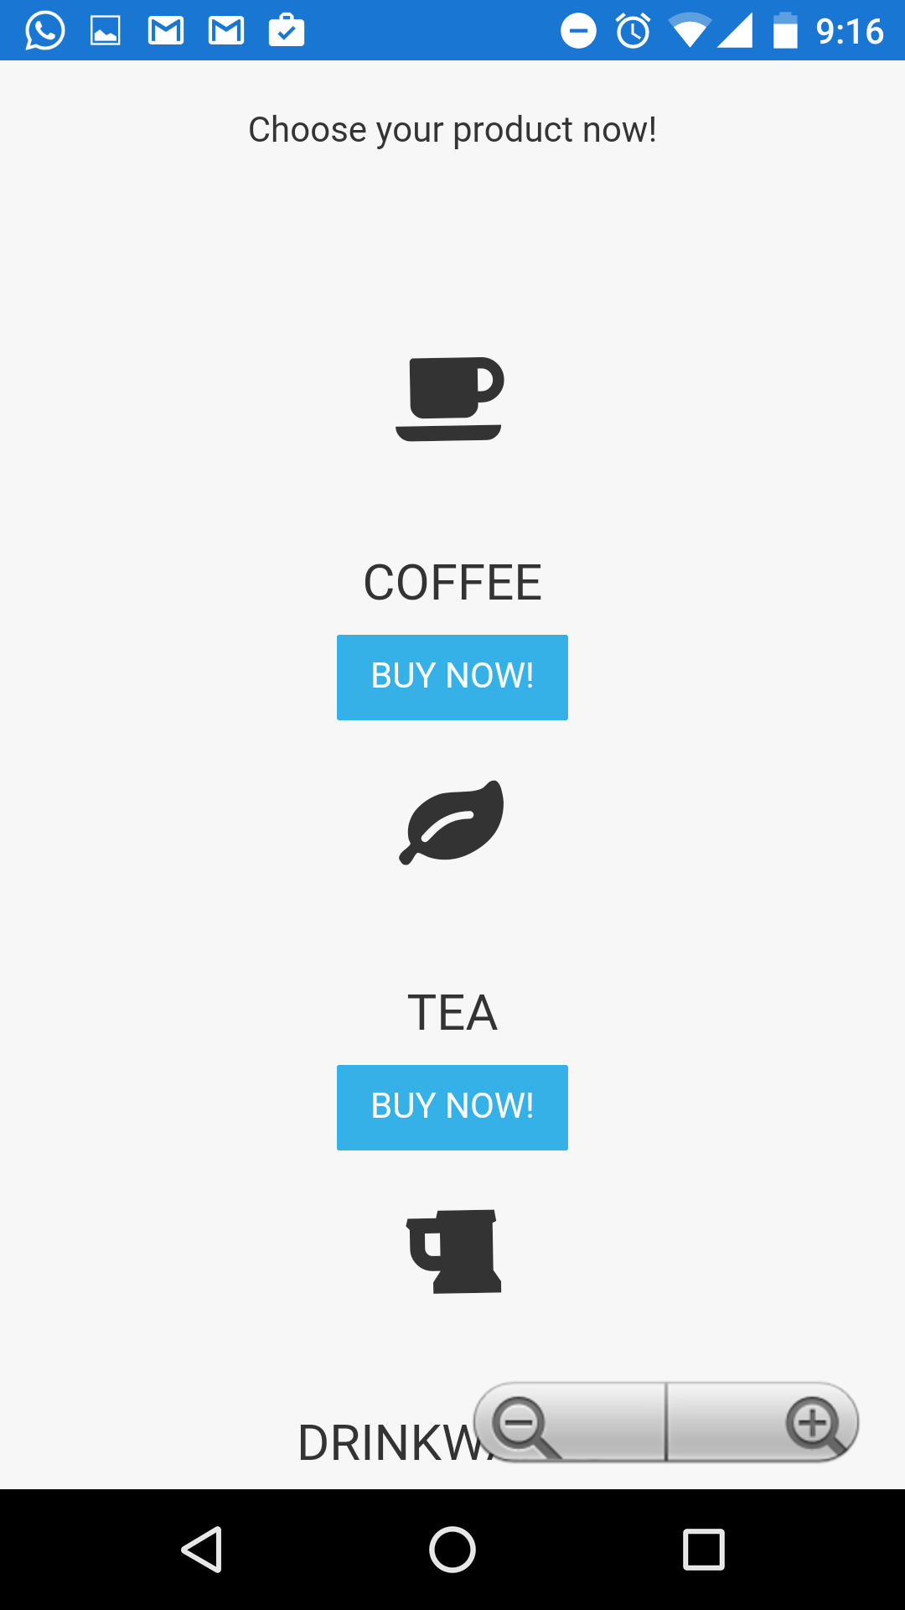

Slide 6
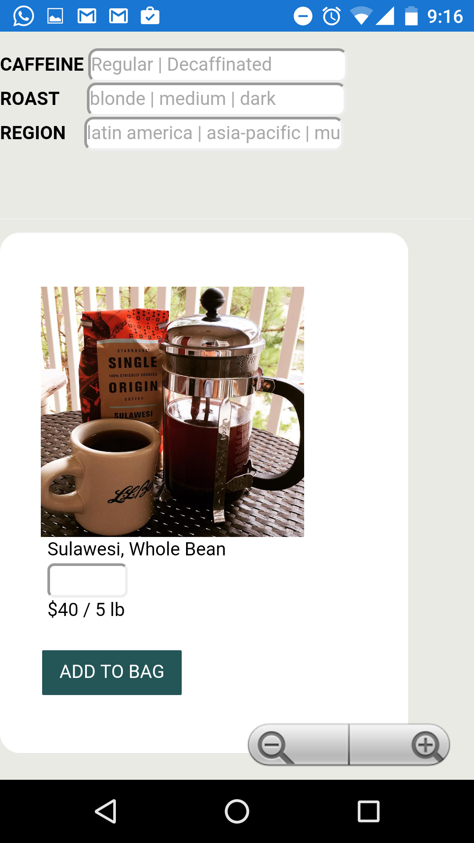
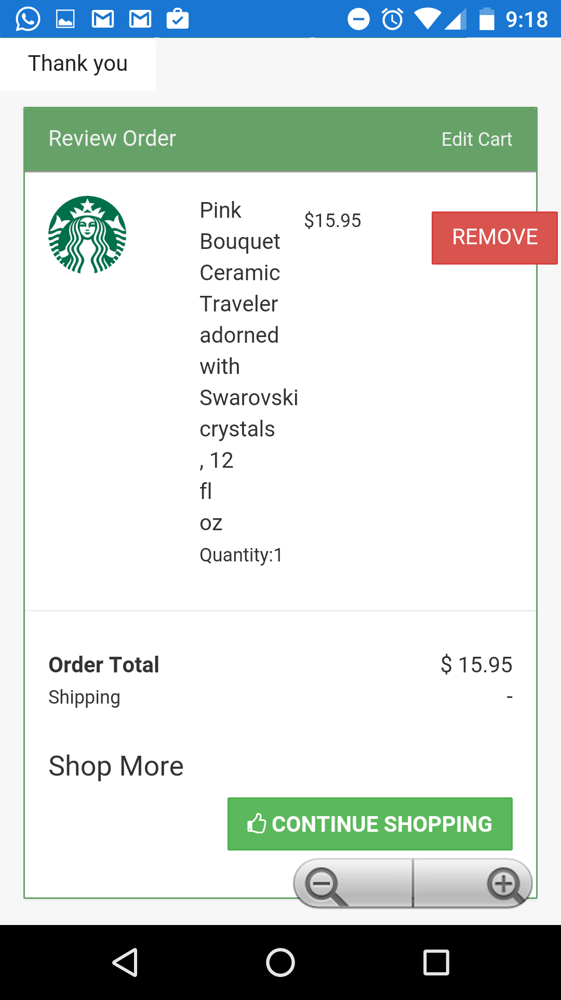

Slide 7
